Slide 1

Parallel Computing
DSBA 6190-U90 | Colby T. Ford, Ph.D.

Slide 2
Overview
Terms
History of Parallel Computing
Intro to Apache Spark

Slide 3
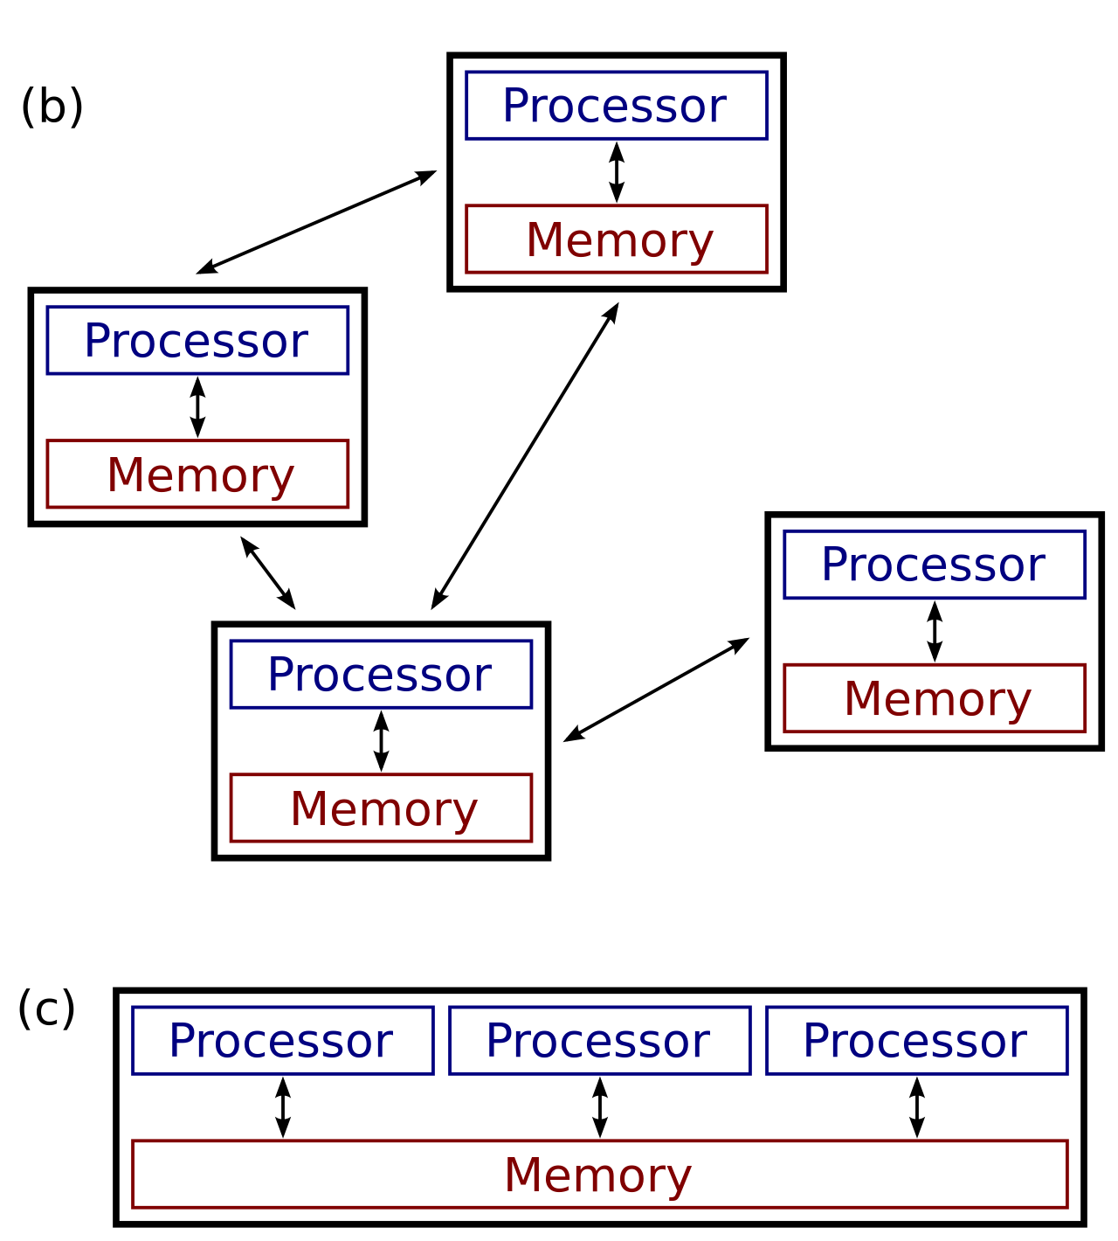
Terms
High Performance Computing
Distributed Computing (b)
Parallel Computing (c)
Using more powerful machines to do computations faster.
Measured in degree of parallelism
Measured in degree of distribution and parallelism
Measured in FLOPS
Using multiple cores to do multiple things at once.
Using multiple machines to do multiple things at once.
File:Distributed-parallel.svg. (2014, August 28). Wikimedia Commons, the free media repository. Retrieved 15:47, October 16, 2019 from https://commons.wikimedia.org/w/index.php?title=File:Distributed-parallel.svg&oldid=132972776.

Slide 4


Technology Pipeline
Multicore
MPI
SNOW

Slide 5

Why Spark?
Open-source data processing engine built around speed, ease of use, and sophisticated analytics
In memory engine that is up to 100 times faster than Hadoop
Largest open-source data project with 1000+ contributors
Highly extensible with support for Scala, Java and Python alongside Spark SQL, GraphX, Streaming and Machine Learning Library (MLlib)
Why Databricks?
Databricks is the premium version of Spark available in the market
Spark founders created Databricks
Spark is the dominant workload in Hadoop
Databricks commits 75% of the code to Open Source Spark
Notes:
When it comes to ease of use, Spark again happens to be a lot better than Hadoop. Spark has APIs for several languages such as Scala, Java and Python, besides having the likes of Spark SQL. It is relatively simple to write user-defined functions. It also happens to boast an interactive mode for running commands. Hadoop, on the other hand, is written in Java and has earned the reputation of being pretty difficult to program, although it does have tools that assist in the process. (To learn more about Spark, see How Apache Spark Helps Rapid Application Development.)
In-Memory Technology
One of the unique aspects of Apache Spark is its unique "in-memory" technology that allows it to be an extremely good data processing system. In this technology, Spark loads all of the data to the internal memory of the system and then unloads it on the disk later. This way, a user can save a part of the processed data on the internal memory and leave the remaining on the disk.
Spark also has an innate ability to load necessary information to its core with the help of its machine learning algorithms. This allows it to be extremely fast.
Spark’s Core
Spark’s core manages several important functions like setting tasks and interactions as well as producing input/output operations. It can be said to be an RDD, or resilient distributed dataset. Basically, this happens to be a mix of data that is spread across several machines connected via a network. The transformation of this data is created by a four-step method, comprised of mapping the data, sorting it, reducing it and then finally, joining the data.
Following this step is the release of the RDD, which is done with support from an API. This API is a union of three languages: Scala, Java and Python.
Spark’s SQL
Apache Spark’s SQL has a relatively new data management solution called SchemaRDD. This allows the arrangement of data into many levels and can also query data via a specific language.
Graphx Service
Apache Spark comes with the ability to process graphs or even information that is graphical in nature, thus enabling the easy analysis with a lot of precision.
Streaming
This is a prime part of Spark that allows it to stream large chunks of data with help from the core. It does so by breaking the large data into smaller packets and then transforming them, thereby accelerating the creation of the RDD.
MLib – Machine Learning Library
Apache Spark has the MLib, which is a framework meant for structured machine learning. It is also predominantly faster in implementation than Hadoop. MLib is also capable of solving several problems, such as statistical reading, data sampling and premise testing, to name a few.

Slide 6
Hadoop MapReduce
MapReduce in Hadoop
VM
VM
VM
Azure Storage
Disk
Disk
VM
VM
VM
Driver
VM
VM
VM
VM
VM
VM
Azure Storage > Driver > VM/Parallelization > write to Disk > VM/Parallelization > write to disk > repeat…
Writing to disk takes time… every time you run this process in MapReduce

Slide 7

What is Azure Databricks?
Apache® Spark™ is FASTER and EASIER than MapReduce in Hadoop
VM
VM
VM
Azure Storage
Cache
Cache
VM
VM
VM
Driver
VM
VM
VM
VM
VM
VM
Faster – In Spark data stays in cache this give Spark the speed over MapReduce (writing to disk)
Easier – You can use the language you are most comfortable with in Spark (Python, Scala, R, SQL)
Notes:
Azure Databricks features –
Enhance your teams’ productivity
Get started quickly by launching your new Spark environment with one click.
Share your insights in powerful ways through rich integration with PowerBI.
Improve collaboration amongst your analytics team through a unified workspace.
Innovate faster with native integration with rest of Azure platform.
Build on the most compliant and trusted cloud
Simplify security and identity control with built-in integration with Active Directory.
Regulate access with fine-grained user permissions to Azure Databricks’ notebooks, clusters, jobs and data.
Build with confidence on the trusted cloud backed by unmatched support, compliance and SLAs.
Scale without limits
Operate at massive scale without limits globally.
Accelerate data processing with the fastest Spark engine.

Slide 8


What is Azure Databricks?
A fast, easy and collaborative Apache® Spark™ based analytics platform optimized for Azure
Best of Databricks
Best of Azure
Designed in collaboration with the founders of Apache Spark
One-click set up; streamlined workflows
Interactive workspace that enables collaboration between data scientists, data engineers, and business analysts.
Native integration with Azure services (Power BI, SQL DW, Cosmos DB, Blob Storage)
Enterprise-grade Azure security (Active Directory integration, compliance, enterprise-grade SLAs)
Notes:
Azure Databricks features –
Enhance your teams’ productivity
Get started quickly by launching your new Spark environment with one click.
Share your insights in powerful ways through rich integration with PowerBI.
Improve collaboration amongst your analytics team through a unified workspace.
Innovate faster with native integration with rest of Azure platform.
Build on the most compliant and trusted cloud
Simplify security and identity control with built-in integration with Active Directory.
Regulate access with fine-grained user permissions to Azure Databricks’ notebooks, clusters, jobs and data.
Build with confidence on the trusted cloud backed by unmatched support, compliance and SLAs.
Scale without limits
Operate at massive scale without limits globally.
Accelerate data processing with the fastest Spark engine.

Slide 9
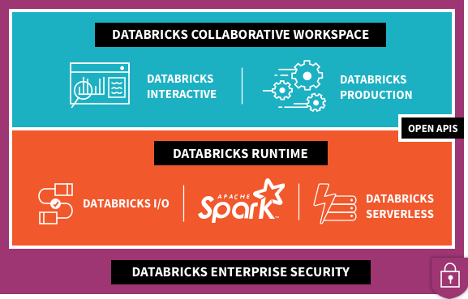


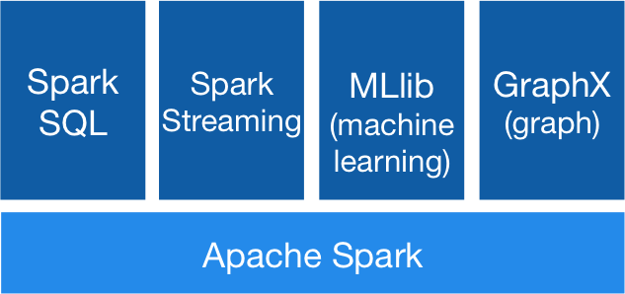



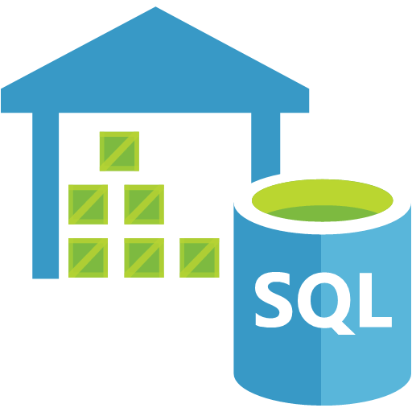
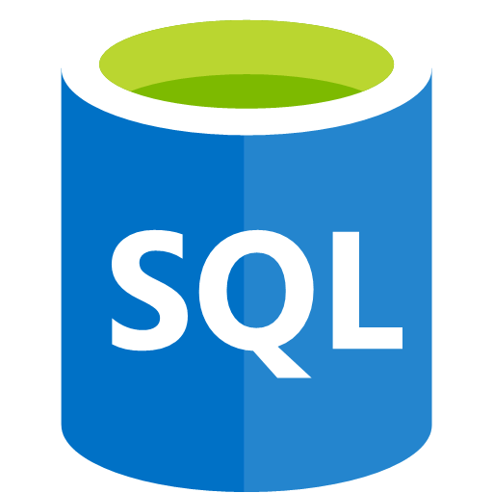




What’s Under the Hood?
2
1
Data Factory
Power BI
3
Data Lake
Store
Blob
Storage
SQL Data
Warehouse
SQL DB
Cosmos DB
Event Hubs
Kafka
On HDInsight

Slide 10
What’s Under the Hood?
Data Factory
Power BI
Data Lake
Store
Blob
Storage
SQL Data
Warehouse
SQL DB
Cosmos DB
Event Hubs
Kafka
On HDInsight

Slide 11



Azure Databricks key audiences & benefits
Data scientist
Data engineer
CDO, VP of analytics
Integrated workspace
Easy data exploration
Collaborative experience
Interactive dashboards
Faster insights
Best Spark & serverless
Databricks managed Spark
Improved ETL performance
Zero management clusters, serverless
Easy to schedule jobs
Automated workflows
Enhanced monitoring & troubleshooting
Automated alerts & easy access to logs
Zero Management Spark
Cluster democratization (High-concurrency)
Fast, collaborative analytics platform accelerating time to market
No dev-ops required
Enterprise grade security
Encryption
End-to-end auditing
Role-based control
Compliance
Unified analytics platform
Provided by Microsoft and Databricks under NDA

Slide 12
eastus2.azuredatabricks.net

Slide 13

Azure Databricks
Azure Databricks
Collaborative Workspace
IoT / streaming data
Machine learning models
DATA ENGINEER
DATA SCIENTIST
BUSINESS ANALYST
Deploy Production Jobs & Workflows
Cloud storage
BI tools
MULTI-STAGE PIPELINES
JOB SCHEDULER
NOTIFICATION & LOGS
Data warehouses
Optimized Databricks Runtime Engine
Data exports
Hadoop storage
DATABRICKS I/O
APACHE SPARK
HIGH-CONCURRENCY
Rest APIs
Data warehouses
Enhance Productivity
Build on secure & trusted cloud
Scale without limits
Notes:
Databricks, founded by the team that created Apache Spark – unified analytics platform that accelerates innovation by unifying data science, engineering & business.
75% of the code committed to Apache Spark comes from Databricks
Unified Runtime
Create clusters in seconds, dynamically scale them up and down.
They’ve made enhancements to Spark engine to make it 10x faster than open source Spark
Serverless- Auto-configured multi-user cluster, Reliable sharing with fault isolation
Unified Collaboration
Overall – a simple & collaborative environment that enables your entire team to use Spark & interact with your data simultaneously
DE – Improve ETL performance, zero management clusters. Execute production code from within notebooks
DS - For data scientists, easy data exploration in notebooks
Business SME – interactive dashboards empower teams to create dynamic reports
Enterprise Security
Encryption
Fine grained Role-based access control (files, clusters, code, application, dashboard)
Compliance
Rest APIs
DE – DBIO, SPARK, API’s , JOBS
DS – Spark and Serverless, Interactive Data Science
Data Products - Everything
Creators of Spark
Training People
Number of Customers
Ingest
Workflow
Schedule / Run / Monitor
Execute
Troubleshoot
Debug
Production Jobs
---------
Ingest, ETL, Scheduling, Monitoring

Slide 14

Big Data & Advanced Analytics at a glance
Ingest
Store
Prep & Train
Model & Serve
Intelligence
Business apps
Data Factory
(Data movement, pipelines & orchestration)
Cosmos DB
DSVM
Databricks
HDInsight
Data Lake Analytics
Predictive apps
Kafka
10 01
Blobs
Data Lake
SQL
SQL Database
Custom apps
SQL Data Warehouse
Operational reports
Event Hub
IoT Hub
Machine Learning
Sensors and devices
Analysis Services
Analytical dashboards
Notes:
Azure build-out of DMSA. Supports hybrid\on-premises too through ADF \ Blob \ Stretch.

Slide 15
Modern Big Data Warehouse
Ingest
Store
Prep & Train
Model & Serve
Intelligence
Logs, files and media (unstructured)
Data factory
Azure storage
Azure Databricks
(Spark)
Business / custom apps
(Structured)
Polybase
Data factory
Azure SQL Data Warehouse
Analytical dashboards

Slide 16
Advanced Analytics on Big Data
Ingest
Store
Prep & Train
Model & Serve
Intelligence
Logs, files and media (unstructured)
Data factory
Azure storage
Azure Databricks
(Spark MLlib, SparkR, sparklyr)
Azure Cosmos DB
Web & mobile apps
Business / custom apps
(Structured)
Polybase
Data factory
Azure SQL Data Warehouse
Analytical dashboards

Slide 17





Modern Data Platform with Azure Databricks
Ingest
Store
Prep and train
Serve
Model Serving
Azure Machine Learning service
Azure Kubernetes service
Azure Event Hubs
Streaming data
Operational Databases
Apps
Cosmos DB, SQL DB
Azure Databricks
Ad-hoc Analysis
Power BI
Batch data
Azure analysis services
Azure Data Factory
Azure Data Lake Storage
Azure SQL data warehouse

Slide 18
Modern Big Data Warehouse
Ingest
Store
Prep & Train
Model & Serve
Intelligence
Logs, files and media (unstructured)
Data factory
Azure storage
Azure Databricks
(Spark)
Business / custom apps
(Structured)
Polybase
Data factory
Azure SQL Data Warehouse
Analytical dashboards

Slide 19
Real-time analytics on Big Data
Ingest
Store
Prep & Train
Model & Serve
Intelligence
Unstructured data
Azure HDInsight (Kafka)
Azure Databricks
(Spark)
Polybase
Azure storage
Azure SQL Data Warehouse
Analytical dashboards

Slide 20



POSITIONING THE DIFFERENT BIG DATA SOLUTIONS
KNOWING THE VARIOUS BIG DATA SOLUTIONS
CONTROL
EASE OF USE
Azure Databricks
Frictionless & Optimized Spark clusters
Azure HDInsight
Workload optimized, managed clusters
Reduced Administration
Azure Marketplace
HDP | CDH | MapR
BIG DATA ANALYTICS
Any Hadoop technology, any distribution
IaaS Clusters
Managed Clusters
Azure Data Lake Analytics
Azure Data Lake Store
BIG DATA STORAGE
Azure Storage

Slide 21
Cluster Architecture
Node
Core
Processor
Processor
Core
Task₅
Task₆
Core
Task…
Task_{n}
Core
Node
Processor₁
Core
Task₁
Core
Task₂
Processor
Core
Task₃
Core
Task₄
Cluster

Slide 22
Spark is Lazy, but in a Smart Way
Transformations
Lazily evaluated.
Actions
Not lazily evaluated.
Multiple transformations add to the steps of a Spark job, but no data gets processed.
Spark operation that returns a DataFrame (usually).
Returns counts of elements or lists of them (usually)
Examples: show/display, count, collect, take, write
Examples: select, filter, groupBy, map
Enacts a series of transformations
When you execute a command, Spark doesn’t actually do anything unless it’s required to show you something or it has to write something out.
This is the difference between a Transformation and an Action.
“Lazy Evaluation”

Slide 23
Spark Pipelines
Can be saved similar to ML models
Provides stability into the model scoring process
Dummy code categorical features
[OneHotEncoder]
Assemble data into a series of vectors
[VectorAssembler]
Scale features [StandardScaler]
Prepare pipeline
[pipeline.fit(dataset)]
Transform data through pipeline
[pipelinemodel.
transform(dataset)]
Define which columns are categorical and numerical

Slide 24
Mllib Models
Define parameter grid
[ParamGridBuilder]
Define evaluation method
[BinaryClassification
Evaluator]
Define cross-validation method
[CrossValidator]
Fit model
[cv.fit(train)]
Transform data through model
[cvModel.transform(test)]
Initialize ML algorithm object
[LogisticRegression]
Evaluate model
[evaluator.
evaluate(predictions)]

